Slide 1


Slide 2

10
AGGREGATE SUPPLY AND AGGREGATE DEMAND
Notes:
Notes and teaching tips: 5, 9, 18, 30, 33, 37, 42, 45, and 49.
To view a full-screen figure during a class, click the expand button.
To return to the previous slide, click the shrink button.
To advance to the next slide, click anywhere on the full screen figure.
Applying the principles of economics to interpret and understand the news is a major goal of the principles course. You can encourage your students in this activity by using the features called Economics in the News.
(1) Before each class, scan the news and select two or three headlines that are relevant to your session today. There is always something that works. Read the headline and ask for comments, interpretation, discussion. Pose questions arising from it that motivate today’s class. At the end of the class, return to the questions and answer them with the tools you’ve been explaining.
(2) Once or twice a semester, set an assignment, for credit, with the following instructions:
(a) Find a news article about an economic topic that you find interesting.
(b) Make a short bullet-list summary of the article.
(c) Write and illustrate with appropriate graphs an economic analysis of the key points in the article.
Use the Economics in the News features in your textbook as models.

Slide 3
After studying this chapter, you will be able to:
Explain what determines aggregate supply in the long run and the short run
Explain what determines aggregate demand
Explain how real GDP and the price level are determined and what causes economic growth, inflation, and cycles
Describe the main schools of thought in macroeconomics today
Copyright © 2019 Pearson Canada Inc.

Slide 4
Aggregate Supply
Quantity Supplied and Supply
The quantity of real GDP supplied is the total quantity that firms plan to produce during a given period.
Aggregate supply is the relationship between the quantity of real GDP supplied and the price level.
We distinguish two time frames associated with different states of the labour market:
Long-run aggregate supply
Short-run aggregate supply

Slide 5
Aggregate Supply
Long-Run Aggregate Supply
Long-run aggregate supply is the relationship between the quantity of real GDP supplied and the price level when real GDP equals potential GDP.
Potential GDP is independent of the price level.
So the long-run aggregate supply curve (LAS) is vertical at potential GDP.
Notes:
The flavour of the Classical-Keynesian controversy. The textbook presents mainstream macroeconomics and does not dwell on controversy. But if you want to convey the flavour of the Classical-Keynesian controversy, you can do so now using the aggregate supply curves. The difference between the upward-sloping SAS and the vertical LAS curve lies at the core of the disagreement between Classical economists, who believe that wages and prices are highly flexible and adjust rapidly, and Keynesian economists, who believe that the money wage rate in particular adjusts very slowly.
Along the LAS curve—two things happening. Students seem comfortable with the idea that the SAS curve has a positive slope; but they seem less at ease with the vertical LAS curve. Emphasize (as the textbook does) the crucial idea that along the LAS curve two sets of prices are changing — the prices of output and the prices of resources, especially the money wage rate. Once they get this point, students quickly catch on to the result that firms won’t be motivated to change their production levels along the LAS curve. The vertical LAS curve is both vital and difficult and class time spent on this concept is well justified.

Slide 6
Aggregate Supply
Short-Run Aggregate Supply
Short-run aggregate supply is the relationship between the quantity of real GDP supplied and the price level when the money wage rate, the prices of other resources, and potential GDP remain constant.
A rise in the price level with no change in the money wage rate and other factor prices increases the quantity of real GDP supplied.
The short-run aggregate supply curve (SAS) is upward sloping.

Slide 7
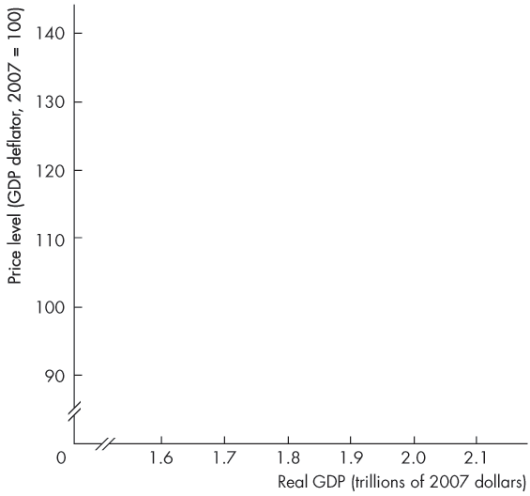
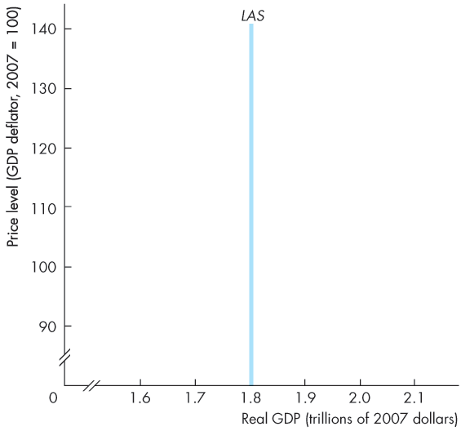
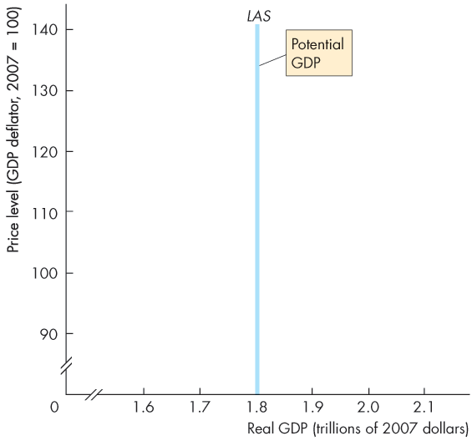
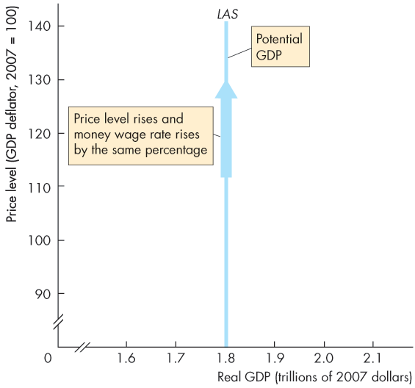

Aggregate Supply
Figure 10.1 shows the LAS curve.
In the long run, the quantity of real GDP supplied is potential GDP.
As the price level rises and the money wage rate changes by the same percentage, the quantity of real GDP supplied remains at potential GDP.

Slide 8
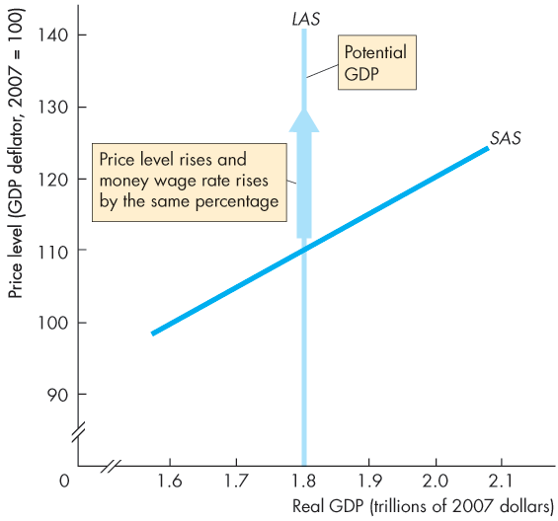
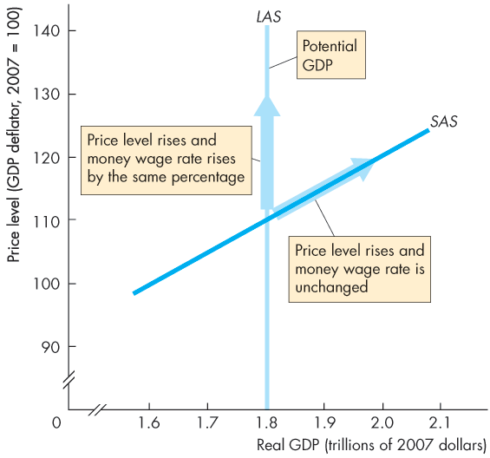
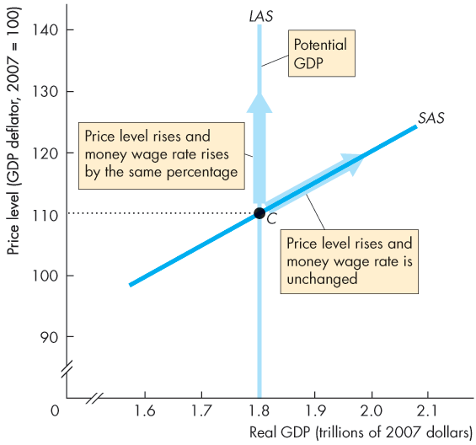
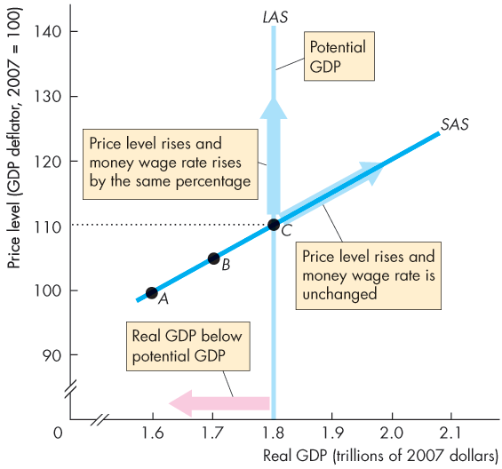
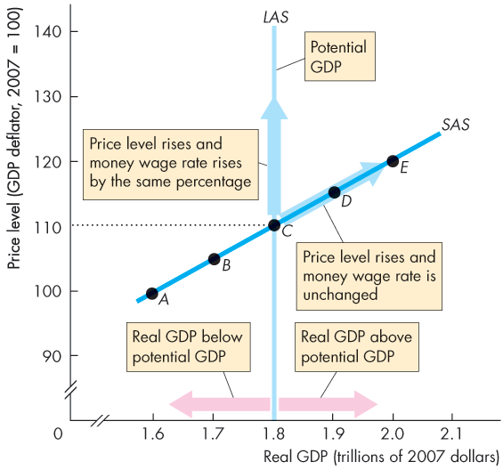

Slide 9
Aggregate Supply
In the short run, the quantity of real GDP supplied increases if the price level rises.
The SAS curve slopes upward.
A rise in the price level with no change in the money wage rate induces firms to increase production.
Notes:
One LAS curve, but many SAS curves. Another way of reinforcing the distinction between the two AS curves is to point out to students that, at any given time, there is just one LAS curve, corresponding to potential GDP. But there is an infinite number of possible SAS curves, each corresponding to a different money wage rate.

Slide 10
Aggregate Supply
With a given money wage rate, the SAS curve cuts the LAS curve at potential GDP.
The price level is 110.
With the given money wage rate, as the price level falls below 110 ...
the quantity of real GDP supplied decreases along the SAS curve.

Slide 11
Aggregate Supply
With the given money wage rate, as the price level rises above 110 …
the quantity of real GDP supplied increases along the SAS curve.
Real GDP exceeds potential GDP.

Slide 12
Aggregate Supply
Changes in Aggregate Supply
Aggregate supply changes if an influence on production plans other than the price level changes.
These influences include
Changes in potential GDP
Changes in money wage rate (and other factor prices)

Slide 13
Aggregate Supply
Changes in Potential GDP
When potential GDP increases, both the LAS and SAS curves shift rightward.
Potential GDP increases if:
The full-employment quantity of labour increases
The quantity of capital (physical or human) increases
An advance in technology occurs

Slide 14
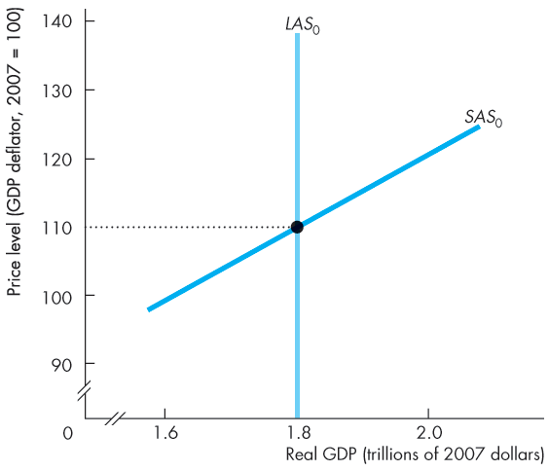
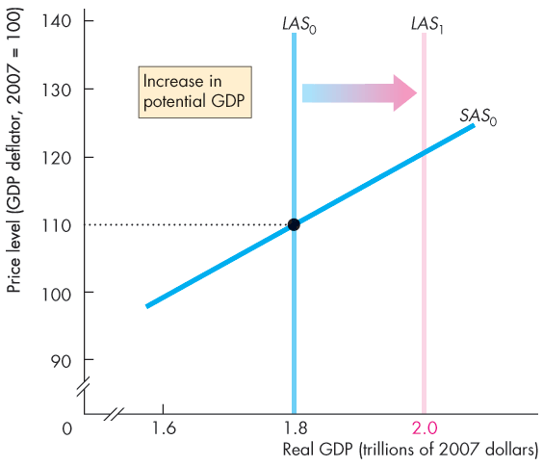
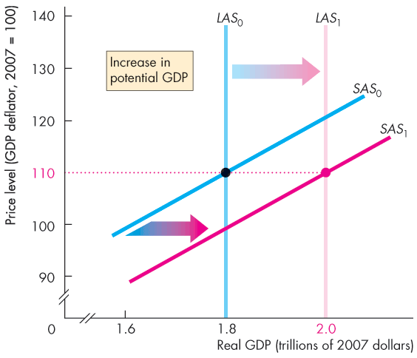

Aggregate Supply
Figure 10.2 shows the effect of an increase in potential GDP.
The LAS curve shifts rightward and …
the SAS curve shifts along with the LAS curve.

Slide 16
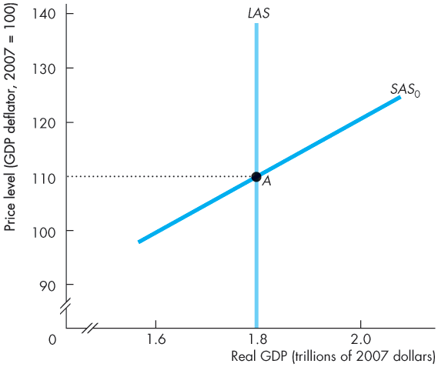
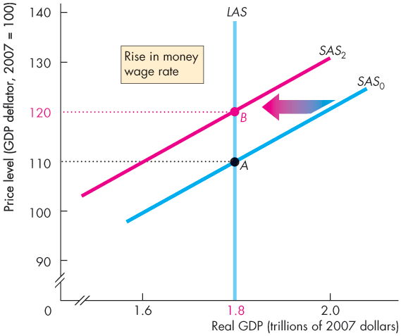
Aggregate Supply
Changes in the Money Wage Rate
Figure 10.3 shows the effect of a rise in the money wage rate.
Short-run aggregate supply decreases and the SAS curve shifts leftward.
Long-run aggregate supply does not change.

Slide 18
Aggregate Demand
The quantity of real GDP demanded, Y, is the total amount of final goods and services produced in Canada that people, businesses, governments, and foreigners plan to buy.
This quantity is the sum of consumption expenditures, C, investment, I, government expenditure, G, and net exports, X – M.
That is,
Y = C + I + G + X – M.
Notes:
Keep it simple. You know that the AD curve is a subtle object—an equilibrium relationship derived from simultaneous equilibrium in the goods market and the money market. This description of the AD curve is not helpful to students in the principles course and is a topic for the intermediate macro course. At the same time that we want to simplify the AD story, we also want to avoid being misleading. The textbook walks that fine line, and we suggest that you stick closely to the textbook treatment and don’t try to convey the more subtle aspects of AD.
Not a strict ceteris paribus event. A major problem with the AD curve is that a change in the price level that brings a movement along the curve is not a strict ceteris paribus event. A change in the price level changes the quantity of real money, which changes the interest rate. Indeed, this chain of events is one of the reasons for the negative slope of the AD curve. In telling this story, we must be sensitive to the fact that the student doesn’t yet know about the demand for money. We must provide intuition with stories (like the Maria stories in the textbook) without referring to the demand for money.
Income equals expenditure on the AD curve. Some instructors want to emphasize a second and more subtle violation of ceteris paribus, that along the AD curve, aggregate planned expenditure equals real GDP. That is, the AD curve is not drawn for a given level of income but for the varying level of income that equals the level of planned expenditure. If you want to make this point when you first introduce the AD curve, you must cover the AE model of Chapter 23 before you cover this chapter. (The material is written in a way that permits this change of order.) If you do not want to derive the AD curve from the equilibrium of the AE model, don’t even mention what’s going on with income along the AD curve. Silence is vastly better than confusion. You can pull this rabbit out of the hat when you get to Chapter 23 if you’re covering that material.

Slide 19
Aggregate Demand
Buying plans depend on many factors and some of the main ones are
The price level
Expectations
Fiscal policy and monetary policy
The world economy

Slide 20
Aggregate Demand
The Aggregate Demand Curve
Aggregate demand is the relationship between the quantity of real GDP demanded and the price level.
The aggregate demand curve (AD) plots the quantity of real GDP demanded against the price level.

Slide 21
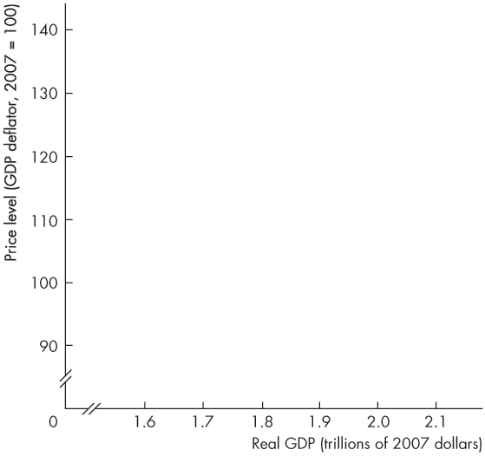
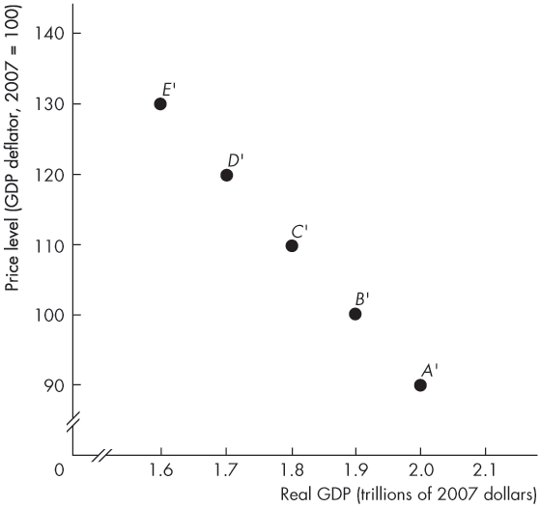
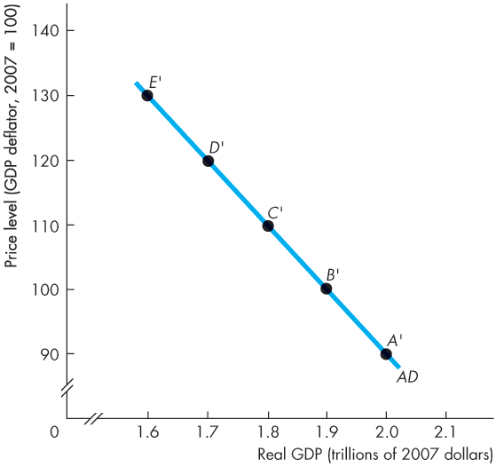

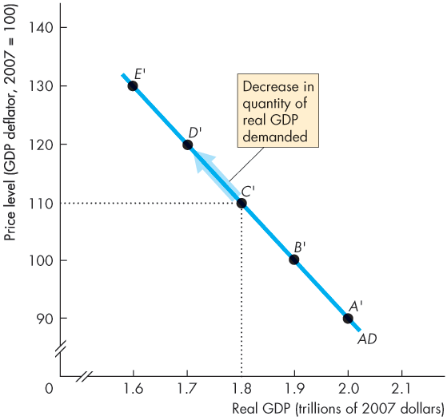
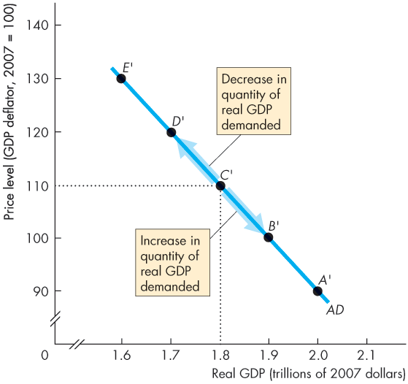
Aggregate Demand
Figure 10.4 shows an AD curve.
As the price level changes the quantity of real GDP demanded moves along the AD curve.
The AD curve slopes downward for two reasons:
Wealth effect
Substitution effects

Slide 23
Aggregate Demand
Wealth Effect
A rise in the price level, other things remaining the same, decreases the quantity of real wealth (money, stocks, etc.).
To restore their real wealth, people increase saving and decrease spending.
The quantity of real GDP demanded decreases.
Similarly, a fall in the price level, other things remaining the same, increases the quantity of real wealth and increases the quantity of real GDP demanded increases.

Slide 24
Aggregate Demand
Substitution Effects
Intertemporal substitution effect:
A rise in the price level, other things remaining the same, decreases the real value of money and raises the interest rate.
When the interest rate rises, people borrow and spend less, so the quantity of real GDP demanded decreases.
Similarly, a fall in the price level increases the real value of money and lowers the interest rate.
When the interest rate falls, people borrow and spend more, so the quantity of real GDP demanded increases.

Slide 25
Aggregate Demand
International substitution effect:
A rise in the price level, other things remaining the same, increases the price of domestic goods relative to foreign goods.
So imports increase and exports decrease, which decreases the quantity of real GDP demanded.
Similarly, a fall in the price level, other things remaining the same, increases the quantity of real GDP demanded.

Slide 26
Aggregate Demand
Changes in Aggregate Demand
A change in any influence on buying plans other than the price level changes aggregate demand.
The main influences on aggregate demand are
Expectations
Fiscal policy and monetary policy
The world economy

Slide 27
Aggregate Demand
Expectations
Expectations about future income, future inflation, and future profits change aggregate demand.
Increases in expected future income increase people’s consumption today and increases aggregate demand.
A rise in the expected inflation rate makes buying goods cheaper today and increases aggregate demand.
An increase in expected future profits boosts firms’ investment, which increases aggregate demand.

Slide 28
Aggregate Demand
Fiscal Policy and Monetary Policy
Fiscal policy is the government’s attempt to influence the economy by setting and changing taxes, making transfer payments, and purchasing goods and services.
A tax cut or an increase in transfer payments increases households’ disposable income—aggregate income minus taxes plus transfer payments.
An increase in disposable income increases consumption expenditure and increases aggregate demand.

Slide 29
Aggregate Demand
Because government expenditure on goods and services is one component of aggregate demand, an increase in government expenditure increases aggregate demand.
Monetary policy is changes in interest rates and the quantity of money in the economy.
An increase in the quantity of money increases buying power and increases aggregate demand.
A cut in interest rates increases expenditure and increases aggregate demand.

Slide 30
Aggregate Demand
The World Economy
The world economy influences aggregate demand in two ways:
A fall in the foreign exchange rate lowers the price of domestic goods and services relative to foreign goods and services, which increases exports, decreases imports, and increases aggregate demand.
An increase in foreign income increases the demand for Canadian exports and increases aggregate demand.
Notes:
Classroom activity
Check out Economics in Action: Central Banks Fight Recession

Slide 31
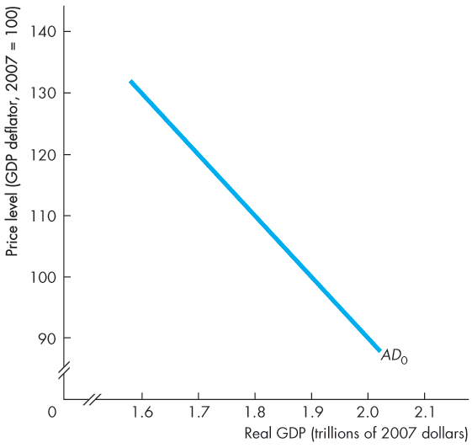
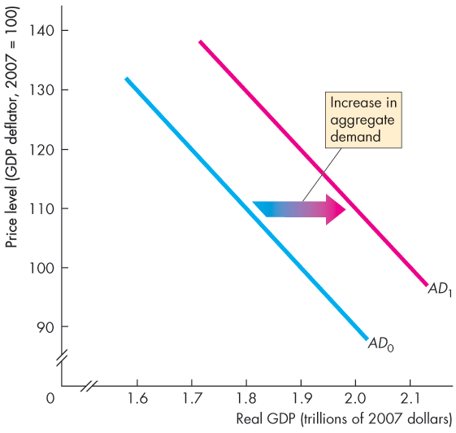
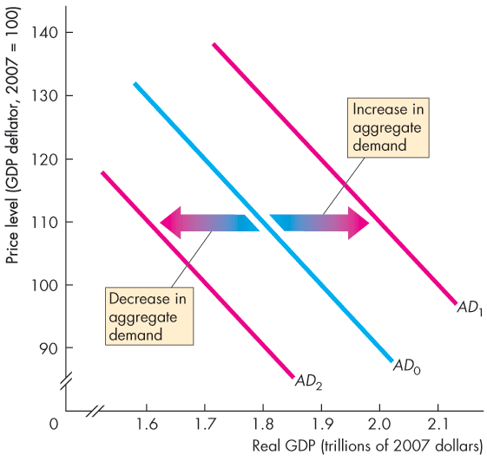
Aggregate Demand
Figure 10.5 illustrates changes in aggregate demand.
When aggregate demand increases, the AD curve shifts rightward …
… and when aggregate demand decreases, the AD curve shifts leftward.

Slide 33
Explaining Macroeconomic Trends and Fluctuations
Short-Run Macroeconomic Equilibrium
Short-run macroeconomic equilibrium occurs when the quantity of real GDP demanded equals the quantity of real GDP supplied at the point of intersection of the AD curve and the SAS curve.
Notes:
Short-run macroeconomic equilibrium. Emphasize that in short-run macroeconomic equilibrium, firms are producing the quantities that maximize profit and everyone is spending the amount that they want to spend. Describe the convergence process using the mechanism laid out on page 516 of the textbook. In that process, firms always produce the profit-maximizing quantities—the economy is on the SAS curve. If they can’t sell everything they produce, firms lower prices and cut production. Similarly, if they can’t keep up with sales and inventories are falling, firms raise prices and increase production. These adjustment processes continues until firms are selling their profit-maximizing output. Emphasize also that with a fixed (sticky) money wage rate, this short-run equilibrium can be at, below, or above potential GDP.

Slide 34
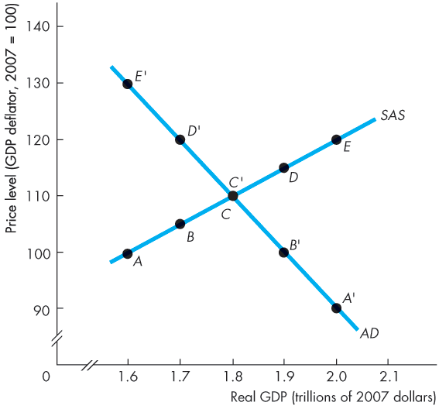
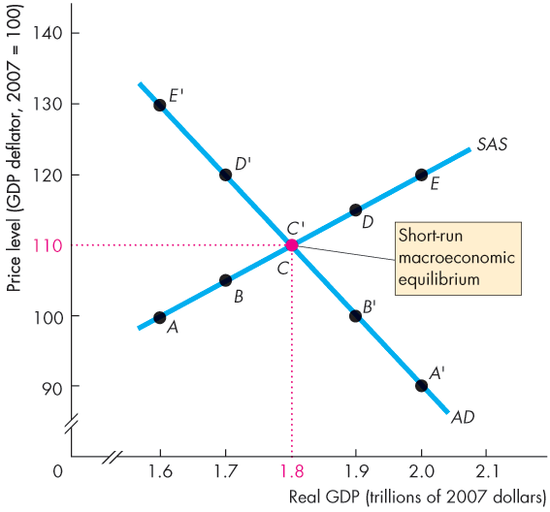
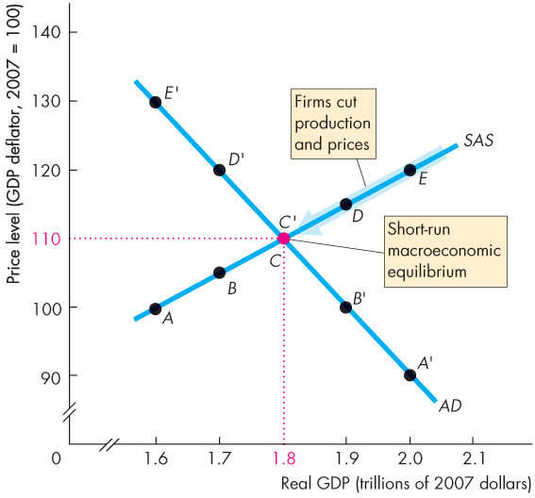
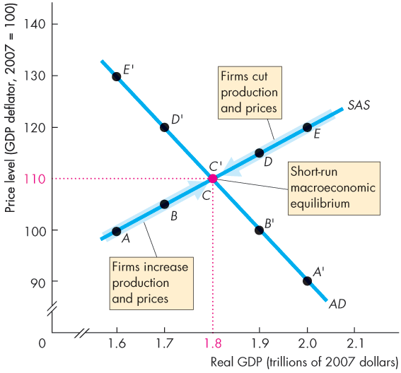
Explaining Macroeconomic Trends and Fluctuations
Figure 10.6 illustrates a short-run equilibrium.
If real GDP is above equilibrium GDP, firms decrease production and lower prices…
… and if real GDP is below equilibrium GDP, firms increase production and raise prices.

Slide 36
Explaining Macroeconomic Trends and Fluctuations
These changes bring a movement along the SAS curve towards equilibrium.
In short-run equilibrium, real GDP can be greater than or less than potential GDP.

Slide 37
Explaining Macroeconomic Trends and Fluctuations
Long-Run Macroeconomic Equilibrium
Long-run macroeconomic equilibrium occurs when real GDP equals potential GDP—when the economy is on its LAS curve.
Long-run equilibrium occurs at the intersection of the AD and LAS curves.
Notes:
Long-run macroeconomic equilibrium. You can use the idea that there is only one LAS curve-but many SAS curves to explain long-run equilibrium. In long-run equilibrium, real GDP equals potential GDP on the one LAS curve. The money wage rate is at the level that makes the SAS curve the one of the infinite number of possible SAS curves that passes through the intersection of AD and LAS curves.
From the short run to the long run. Explain that market forces move the money wage rate to the long-run equilibrium level. At money wage rates below the long-run equilibrium level, there is a shortage of labour, so the money wage rate rises. At money wage rates above the long-run equilibrium level, there is a surplus of labour, so the money wage rate falls. At the long-run equilibrium money wage rate, there is neither a shortage nor a surplus of labour and the money wage rate remains constant.
Shifting the SAS curve. Reinforce the movement toward long-run equilibrium with a curve-shifting exercise. Take the case where the AD curve shifts rightward. The fact that the initial equilibrium occurs where the new AD curve intersects the SAS curve is not difficult. But the notion that the SAS curve shifts leftward as time passes is difficult for many students. The trick to making this idea clear is to spend enough time when initially discussing the SAS so that the students realize that wages and other input prices remain constant along an SAS curve. Once the students see this point, they can understand that, as input prices increase in response to the higher level of (output) prices, the SAS curve shifts leftward.
Avoid confusing students by using ‘up’ to correspond to a decrease in SAS. But do point out that that when the SAS curve shifts leftward it is moving vertically upward, as input prices rise to become consistent with potential GDP and the new long-run equilibrium price level. Most students find it easier to see why the SAS curve shifts leftward once they see that rising input prices shift the curve vertically upward.

Slide 38
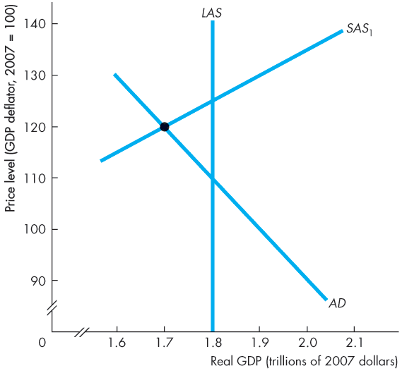
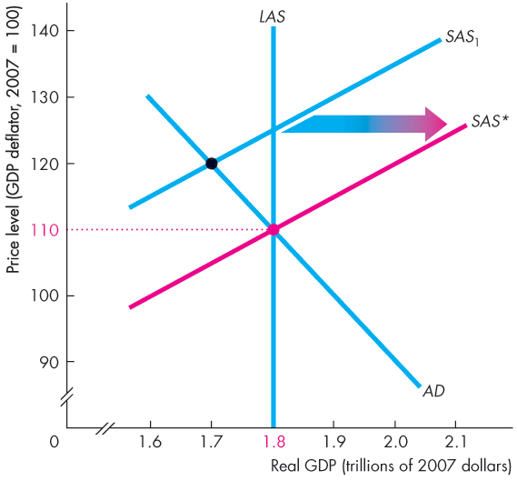
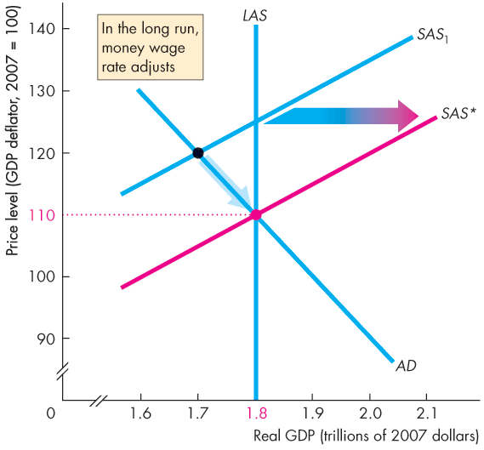
Explaining Macroeconomic Trends and Fluctuations
Figure 10.7 illustrates the adjustment to long-run equilibrium.
Initially, the economy is at below-full employment equilibrium.
In the long run, the money wage falls until the SAS curve passes through the long-run equilibrium point.

Slide 40
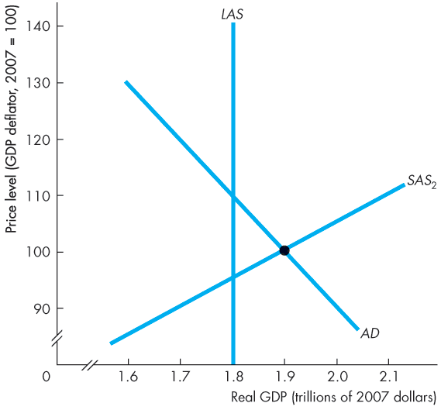
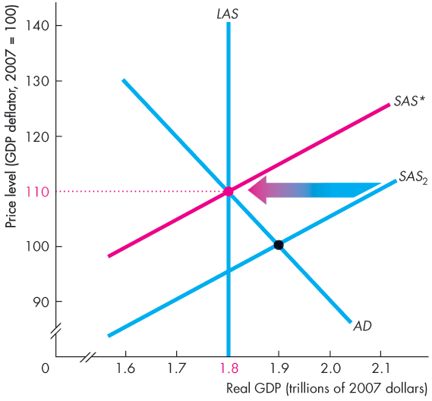
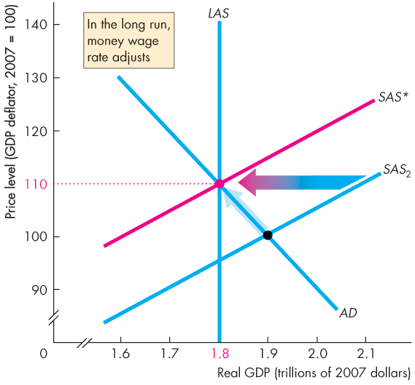

Explaining Macroeconomic Trends and Fluctuations
Initially, the economy is at an above-full employment equilibrium.
In the long run, the money wage rises until the SAS curve passes through the long-run equilibrium point.

Slide 42
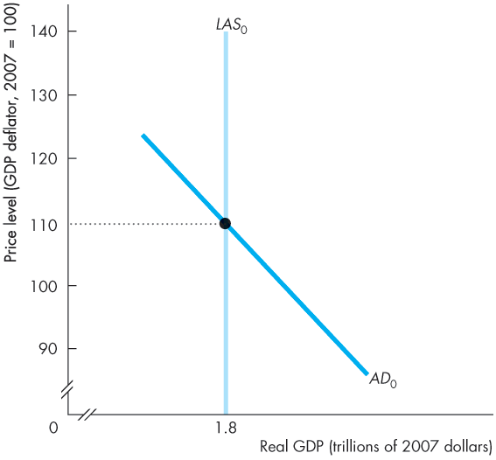
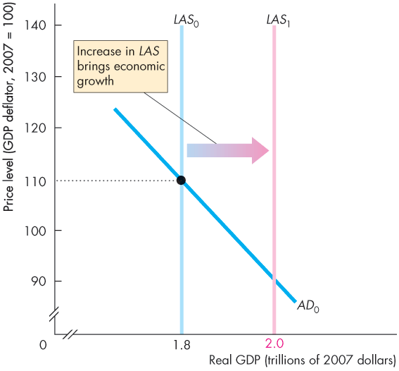
Explaining Macroeconomic Trends and Fluctuations
Economic Growth in the AS-AD Model
Figure 10.8 illustrates economic growth.
Because the quantity of labour grows, capital is accumulated, and technology advances, potential GDP increases.
The LAS curve shifts rightward.
Notes:
Classroom activity
Check out Economics in Action: Canadian Economic Growth and Inflation

Slide 43
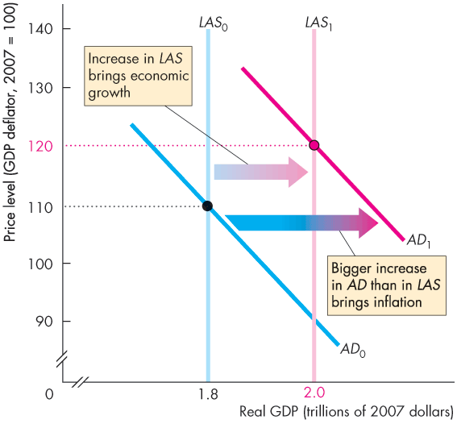
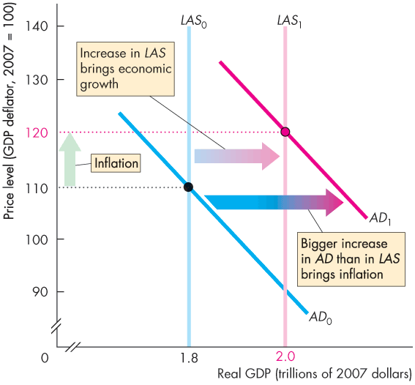
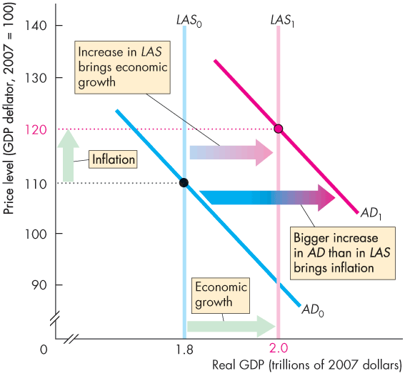

Slide 44
Explaining Macroeconomic Trends and Fluctuations
Figure 10.8 also illustrates inflation.
If the quantity of money grows faster than potential GDP, aggregate demand increases by more than long-run aggregate supply.
The AD curve shifts faster than the LAS curve shifts.
Inflation and economic growth occur.

Slide 45
Explaining Macroeconomic Trends and Fluctuations
The Business Cycle in the AS-AD Model
The business cycle occurs because aggregate demand and the short-run aggregate supply fluctuate, but the money wage does not change rapidly enough to keep real GDP at potential GDP.
An above full-employment equilibrium is an equilibrium in which real GDP exceeds potential GDP.
A full-employment equilibrium is an equilibrium in which real GDP equals potential GDP.
A below full-employment equilibrium is an equilibrium in which potential GDP exceeds real GDP.
Notes:
Classroom activity
Check out Economics in Action: The Canadian Business Cycle

Slide 46
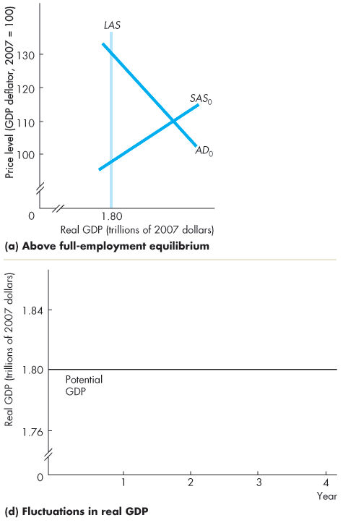
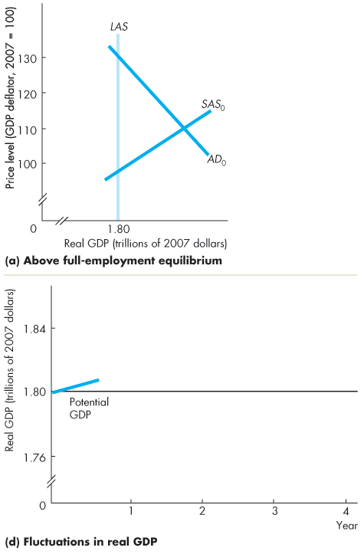
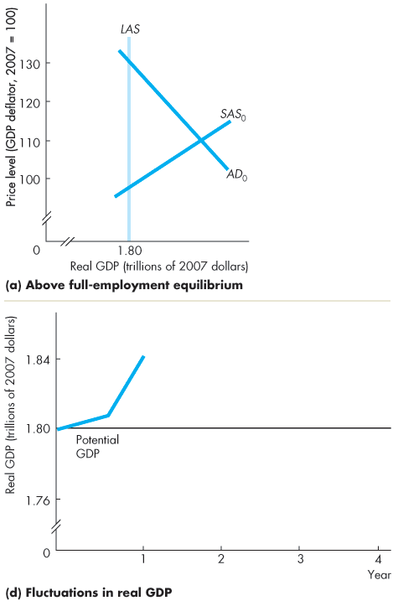

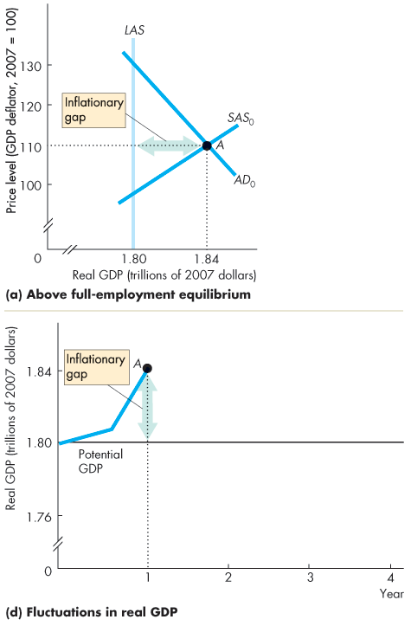
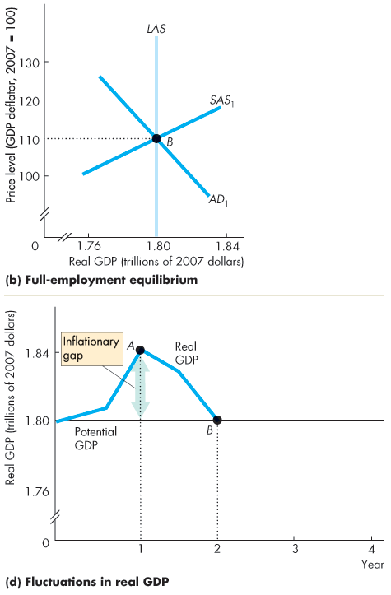
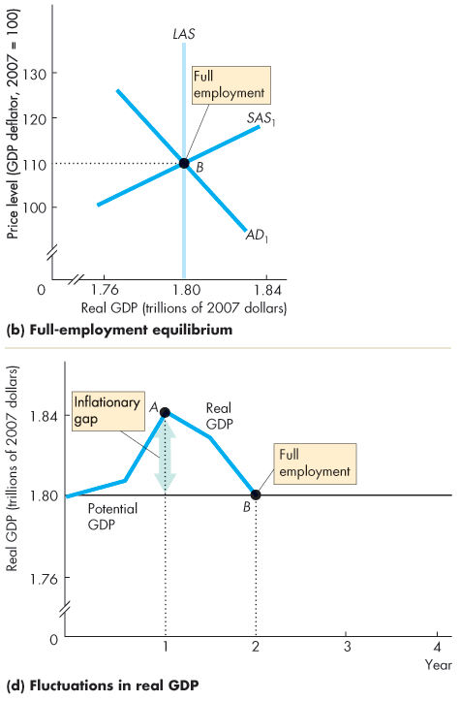
Explaining Macroeconomic Trends and Fluctuations
Figures 10.9(a) and (d) illustrate above full-employment equilibrium.
The amount by which potential GDP exceeds real GDP is called a inflationary gap.
Figures 10.9(b) and (d) illustrate full-employment equilibrium.

Slide 47
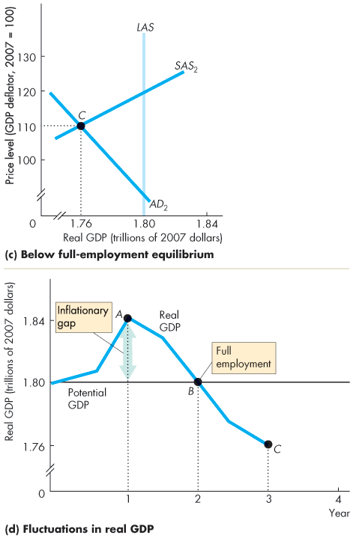
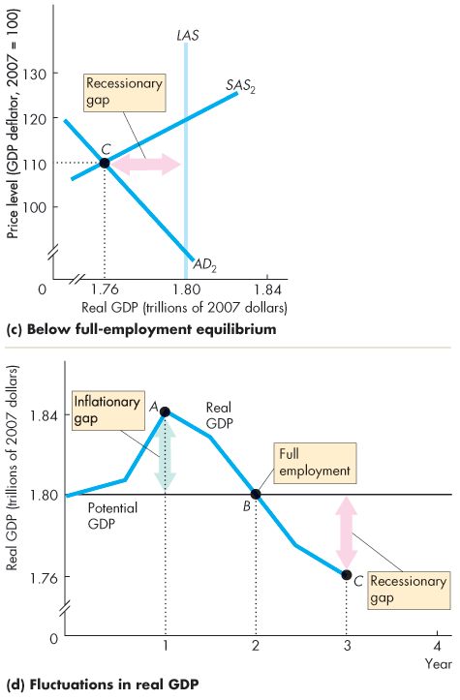
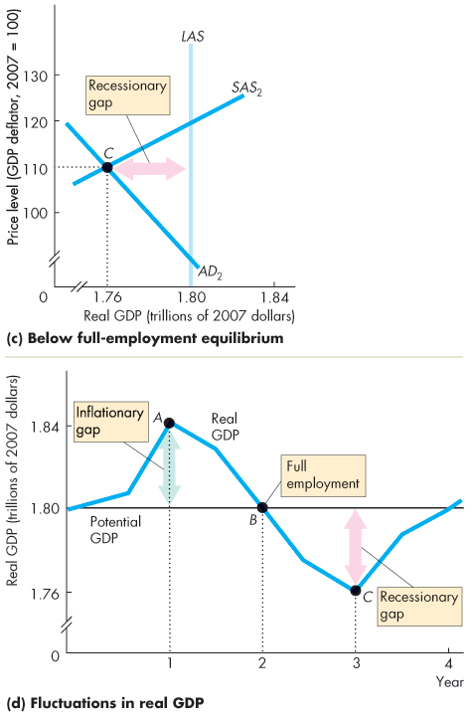

Slide 48
Explaining Macroeconomic Trends and Fluctuations
Figures 10.9(c) and (d) illustrate below full-employment equilibrium.
When real GDP is less than potential GDP, the gap is called a recessionary gap.
Figure 10.9(d) shows how, as the economy moves from one short-run equilibrium to another, real GDP fluctuates around potential GDP in a business cycle.

Slide 49
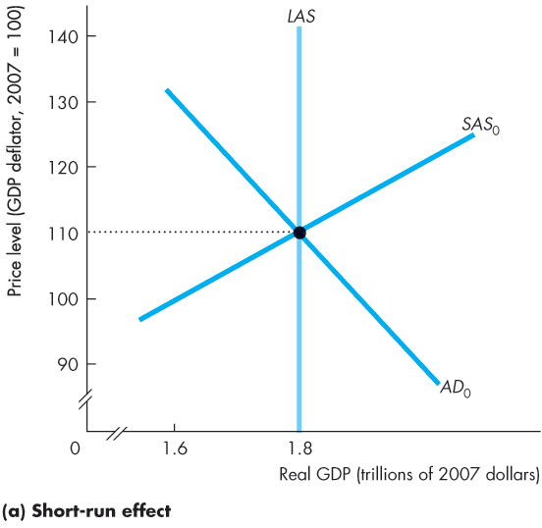
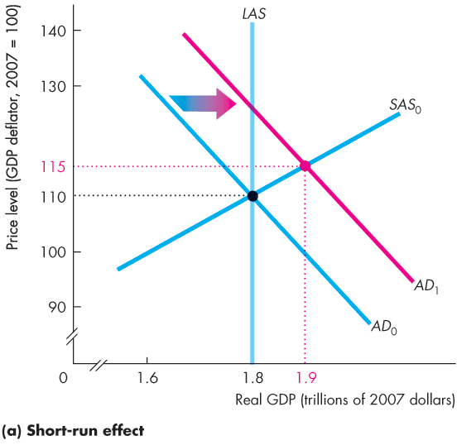
Explaining Macroeconomic Trends and Fluctuations
Fluctuations in Aggregate Demand
Figure 10.10 shows the effects of an increase in aggregate demand.
An increase in aggregate demand shifts the AD curve rightward.
Firms increase production and the price level rises in the short run.
Notes:
Putting the AS-AD model to work. Don’t neglect the predictions of the model. This is the payoff for the student. With this simple model, we can now say quite a lot about growth, inflation, and the cycle.
The price level doesn’t fall, and real GDP rarely falls. The AS-AD model predicts a fall in the price level when either aggregate demand decreases or aggregate supply increases. And the model predicts that real GDP decreases when either aggregate supply or aggregate demand decreases. Students are sometimes bothered by this apparent mismatch between the predictions of the model and the observed economy. The best way to handle this issue is to emphasize that in our actual economy, AS and AD almost always are increasing. When we use the model to simulate the effects of a decrease in either AS or AD, we’re studying what happens relative to the trends in real GDP and the price level. A fall in the price level in the model translates into a lower price level than would otherwise have occurred and a slowing of inflation. The story is similar for real GDP.
Classroom activity
Check out Economics in the News: Aggregate Supply and Aggregate Demand in Action

Slide 51
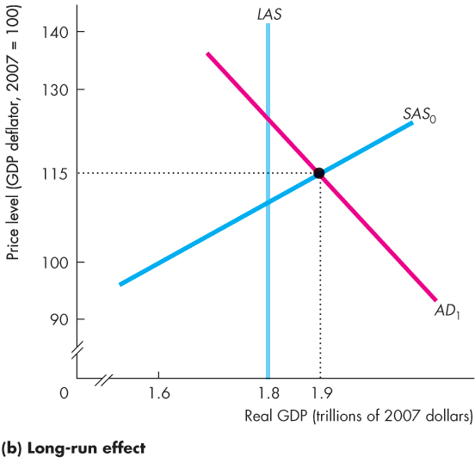
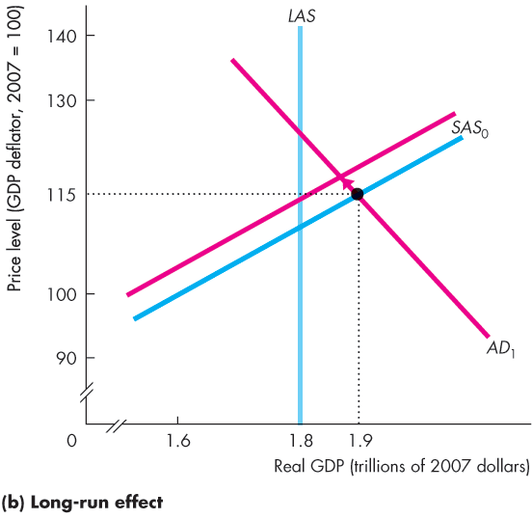



Explaining Macroeconomic Trends and Fluctuations
At the short-run equilibrium, there is an inflationary gap.
The money wage rate begins to rise and the SAS curve starts to shift leftward.
The price level continues to rise and real GDP continues to decrease until it equals potential GDP.

Slide 53


Explaining Macroeconomic Trends and Fluctuations
Fluctuations in Aggregate Supply
Figure 10.11 shows the effects of a rise in the price of oil.
The SAS curve shifts leftward.
Real GDP decreases and the price level rises.
The economy experiences stagflation.

Slide 55
Macroeconomic Schools of Thought
Macroeconomists can be divided into three broad schools of thought:
Classical
Keynesian
Monetarist

Slide 56
Macroeconomic Schools of Thought
The Classical View
A classical macroeconomist believes that the economy is self-regulating and always at full employment.
The term “classical” derives from the name of the founding school of economics that includes Adam Smith, David Ricardo, and John Stuart Mill.
A new classical view is that business cycle fluctuations are the efficient responses of a well-functioning market economy that is bombarded by shocks that arise from the uneven pace of technological change.

Slide 57
Macroeconomic Schools of Thought
The Keynesian View
A Keynesian macroeconomist believes that left alone, the economy would rarely operate at full employment and that to achieve and maintain full employment, active help from fiscal policy and monetary policy is required.
The term “Keynesian” derives from the name of one of the twentieth century’s most famous economists, John Maynard Keynes.
A new Keynesian view holds that not only is the money wage rate sticky but also are the prices of goods sticky.

Slide 58
Macroeconomic Schools of Thought
The Monetarist View
A monetarist is a macroeconomist who believes that the economy is self-regulating and that it will normally operate at full employment, provided that monetary policy is not erratic and that the pace of money growth is kept steady.
The term “monetarist” was coined by an outstanding twentieth-century economist, Karl Brunner, to describe his own views and those of Milton Friedman.

